Slide 1
Object Oriented Programming Paradigm

Slide 2
Class

Slide 3
A class is a collection of objects of similar type.

Slide 4
Object

Slide 5
Objects are the basic run time entities in an object oriented system. They may represent a person, a bank account, a table of data or any item.

Slide 6
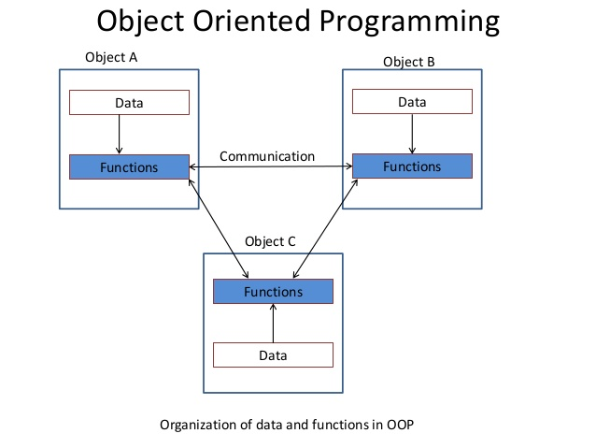

Slide 7
Characteristics of Object Oriented Programming
Emphasis is on data rather than procedure.
Programs are divided into objects
Functions that operate on data of an object are tied together.

Slide 8
Data is hidden and cannot be accessed by external functions.
Objects may communicate with each other through functions.
New data and functions can be added whenever necessary.
Follows bottom up approach in program design.

Slide 9
Object Oriented Languages

Slide 10
Object Oriented Languages are divided into two categories.
Object based Programming languages
Object Oriented Programming Languages

Slide 11
Object based Programming languages:
Major features that are required for object based programming are:
Data Encapsulation
Data hiding and access mechanism
Automatic initialization and clear up objects
Operator overloading

Slide 12
Object Oriented Programming languages:
Major features that are required for object oriented programming are:
Object based Features
Inheritance
Dynamic Binding

